Slide 1
TEL AVIV UNIVERSITY
School of Electrical Engineering
Game of Drones: "Pong" like Drone AR game
by Guy Hershtig
Under the supervision of Mr. Yonatan Mandel and Prof. Amit Bermano In collaboration with the Game Technology Center – ETH Zurich.
May 2020
https://github.com/tau-adl/GameOfDrones

Slide 2
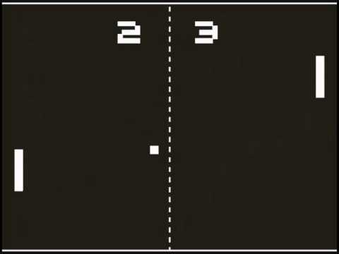
Outline
Project goals
Motivation
Prior art
Approach
Results
Discussion & Conclusions
Future work

Slide 3

Project Goals
3D AR game
Mobile device
Drone player
Multiplayer
Wi-Fi or Internet

Slide 4
Motivation
Explore drone games
Collaboration with AR group
Project as a platform

Slide 5
AR prior art
First AR prototype - Ivan Sutherland, Harvard Uni. 1960s
ARToolKit – 1990s
Personal assistance – 2004
Automotive & Aerospace – 2005
Medical sector – 2006
Military & Tourism sector – 2009, 2010
Gaming

Slide 6
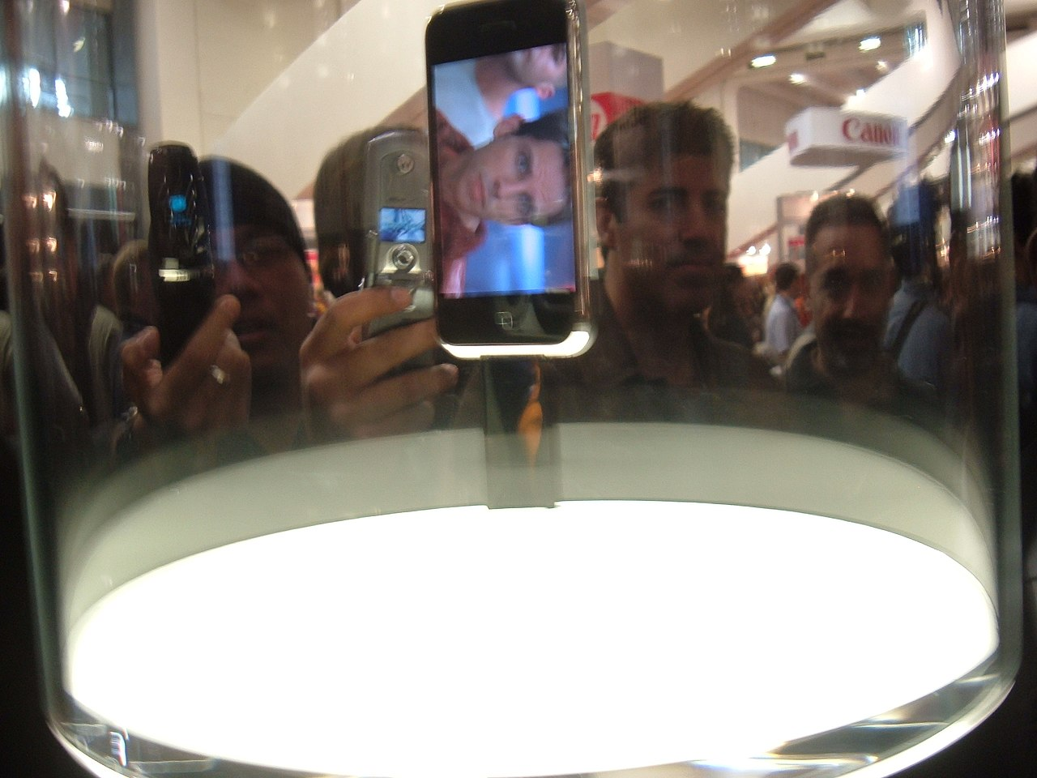
AR games prior art
AR Gaming (Indoor/Outdoor): - AR2 Hockey – 1998 - Collaboratory AR game – 2000 - Human PacMan – 2004 - AR-Bowling – 2004
- Pokémon-Go – 2016 …
First iPhone released - 2007

Slide 7
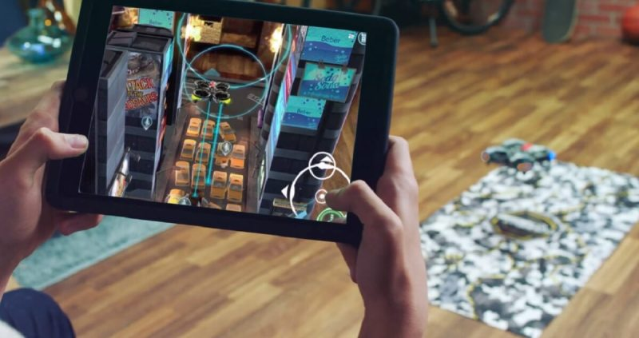
AR/Drone prior art
Drone games: - AR Racing game – 2007 - Drone Racing – 2012 - Air Hog Connect – 2016
Air Hogs Connect
https://www.youtube.com/watch?v=Faww1TMs2n8

Slide 8
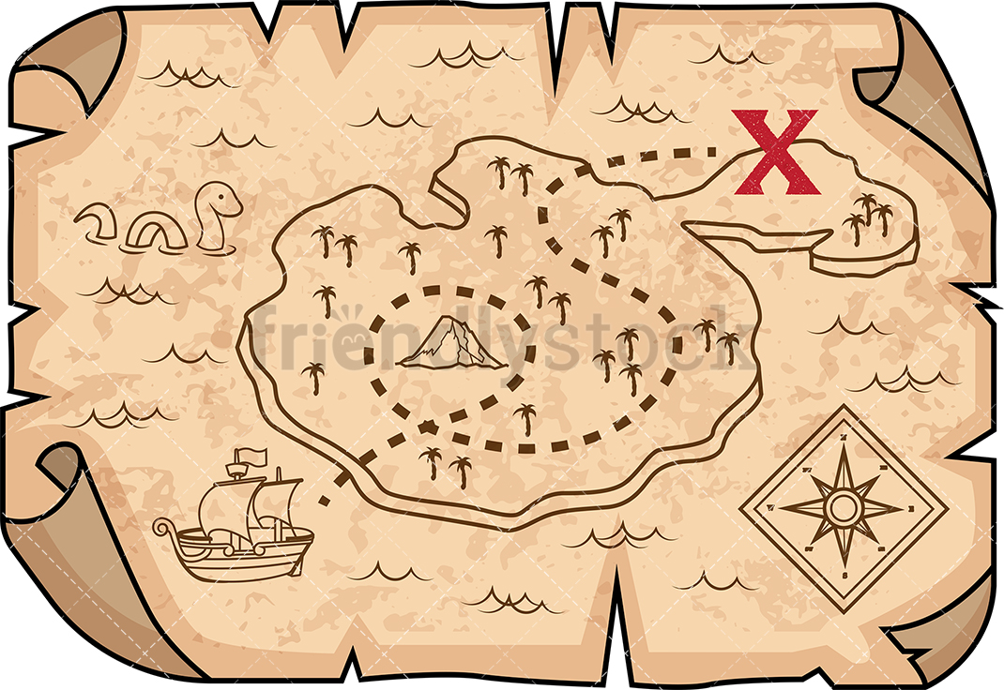
Approach – divide & conquer
Programming tools (Unity, C#)
Drone communication
Detection / Tracking / Positioning
Networking

Slide 9
Approach

Slide 10
Approach – Programming tools
Unity 2019.2.12f1
Unity Hub 2.2.2
Vuforia 8.5.9
Visual Studio 2019 16.5.4
JDK 1.8.0_221
NDK 20.0.5594570

Slide 11
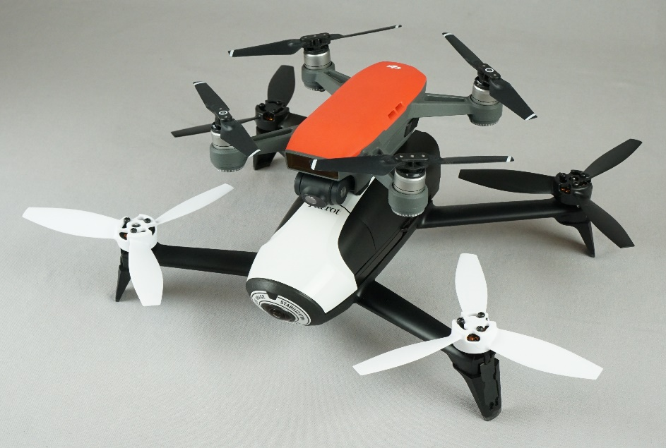


Approach – Drone (Tello vs Parrot)
Use: indoor
Use: Outdoor
Air time
Tello Edu
Parrot Bebop 2

Slide 12
Approach – Drone (Tello vs Parrot)
Use: indoor
Use: Outdoor
Air time
Tello Edu
Parrot Bebop 2

Slide 13
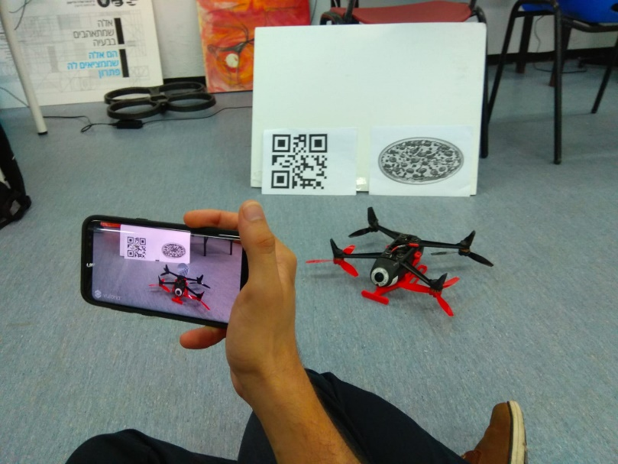
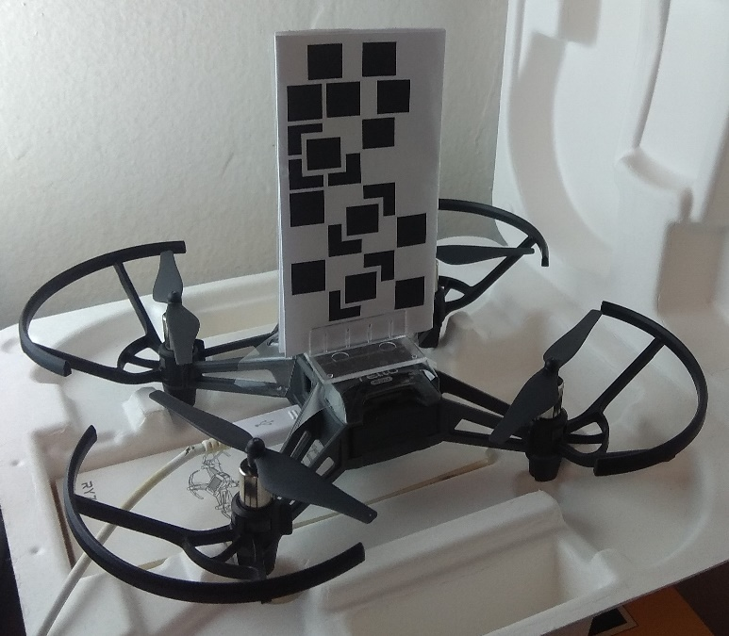
Approach – Vuforia target (3D vs 2D model)
Speed/Reliability
Accuracy
Complexity
Tello 3D model
Tello with QR

Slide 14
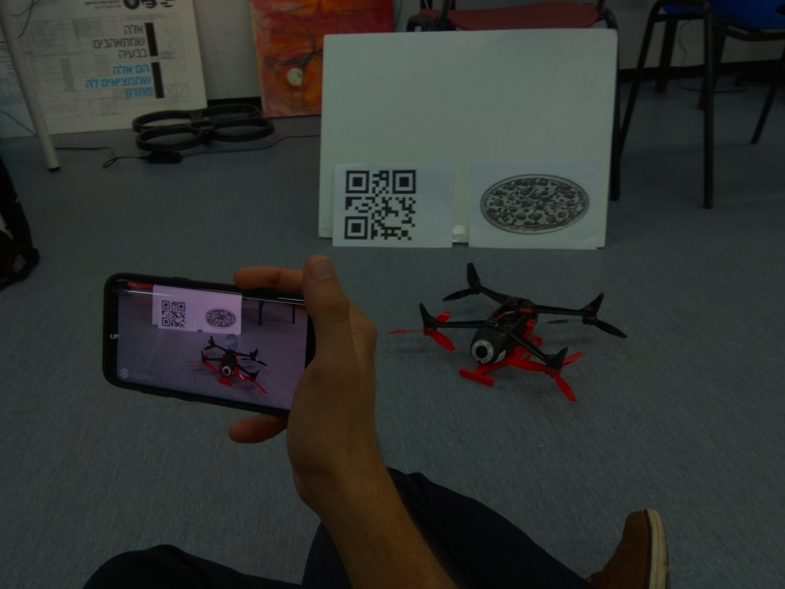
Approach – Vuforia target (3D vs 2D model)
Speed/Reliability
Accuracy
Complexity
Tello 3D model
Tello with QR

Slide 15
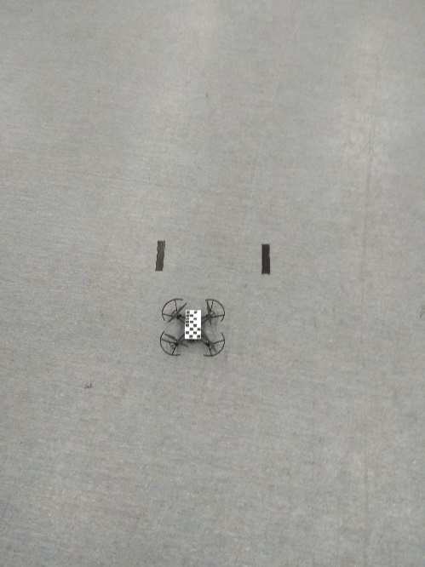
Approach – Vuforia target (QR orientation)
Detection/Tracking
Cell position
Target size
Drift (?)
Parallel
Perpendicular

Slide 16
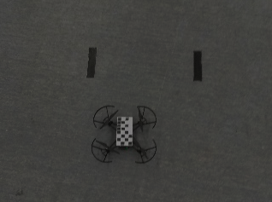
Approach – Vuforia target (QR orientation)
Detection/Tracking
Cell position
Target size
Drift (?)
Parallel
Perpendicular

Slide 17
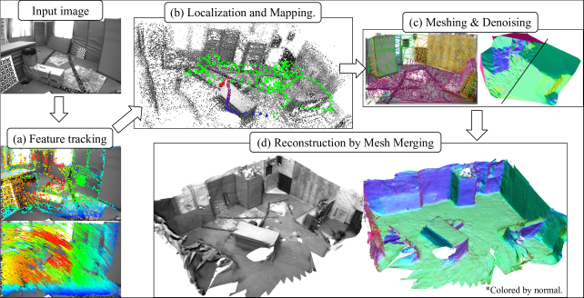
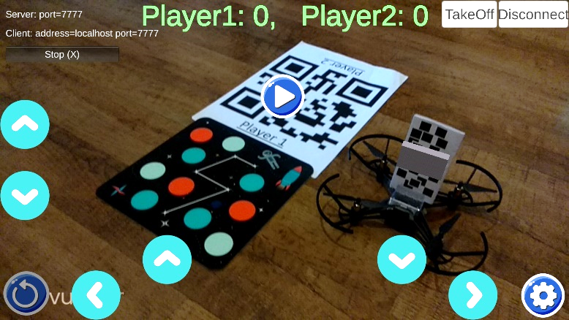
Approach – Vuforia target (SLAM vs Target)
Power
Accuracy
Complexity
SLAM
Mission Pad, Board QR

Slide 18
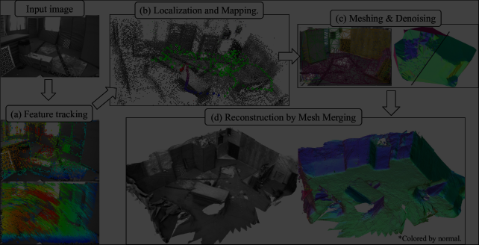
Approach – Vuforia target (SLAM vs Target)
Power
Accuracy
Complexity
SLAM
Mission Pad, Board QR

Slide 19
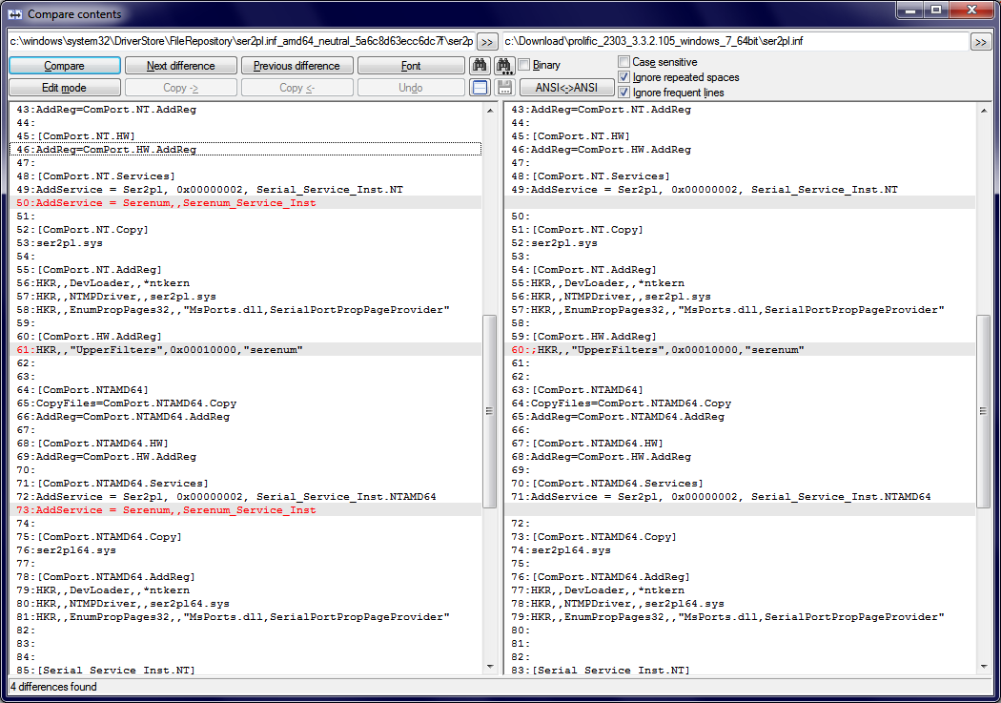
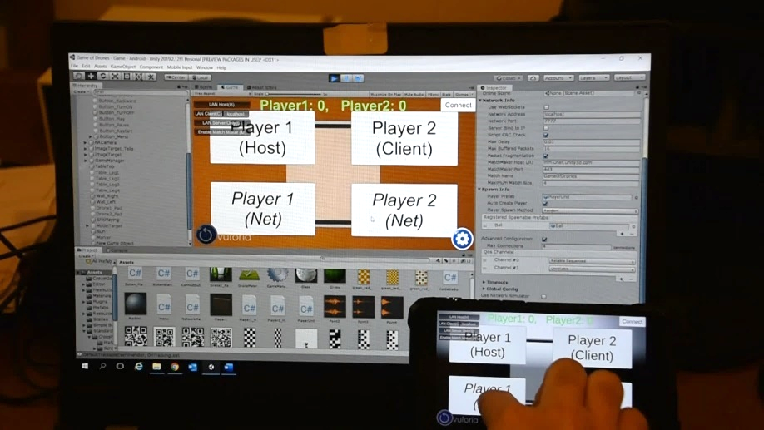
Approach – UNET vs Proprietary networking
Speed
Flexibility
Risk
Proprietary Networking
UNET
https://support.unity3d.com/hc/en-us/articles/360001252086-UNet-Deprecation-FAQ

Slide 20
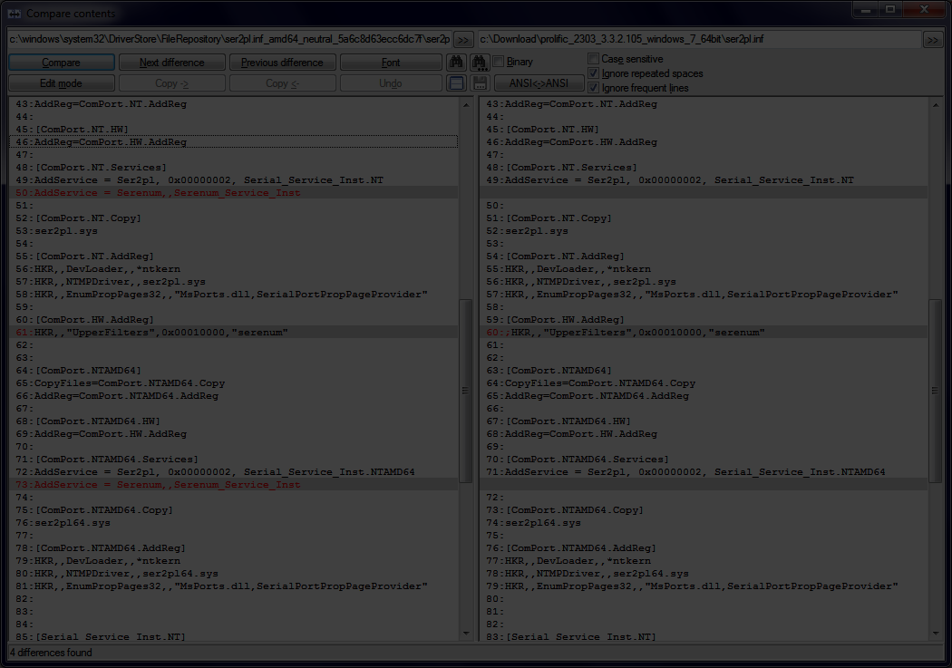
Approach – UNET vs Proprietary networking
Speed
Flexibility
Risk
Proprietary Networking
UNET
https://support.unity3d.com/hc/en-us/articles/360001252086-UNet-Deprecation-FAQ

Slide 21
Results

Slide 22
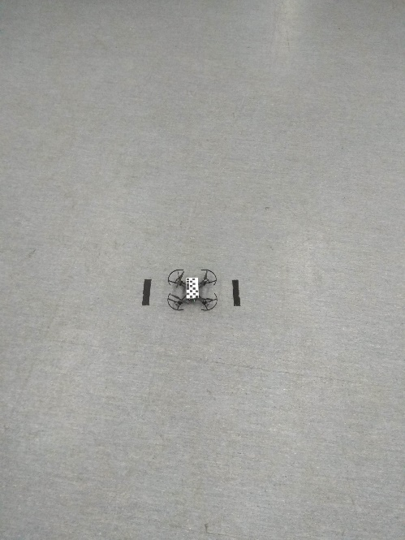
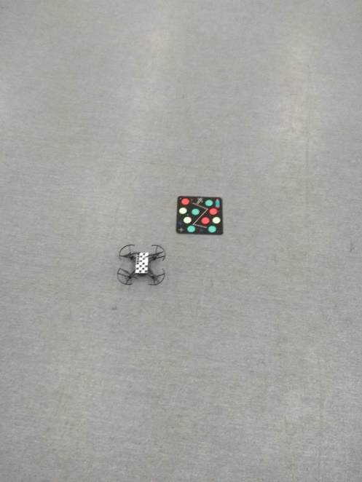
Results - drift measurement*
Initial position
Final position 1
Final position 2
* TakeOff + 45sec of air time (no commands) + Land

Slide 23
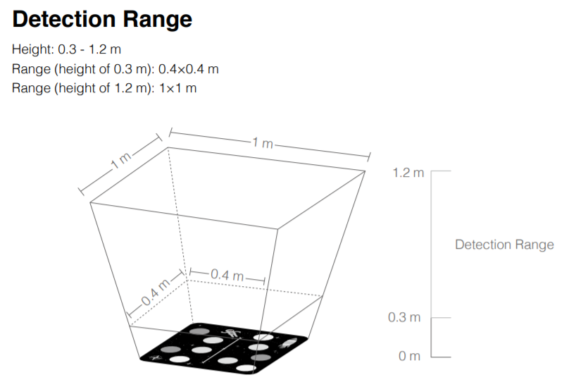
Results – Mission Pad
Small detection area
Best height ~1m
Require switching on
Mission Pad detection area (Tello User Guide)
https://dl-cdn.ryzerobotics.com/downloads/Tello/ Tello%20Mission%20Pad%20User%20Guide.pdf
Notes:
Pad size is ~0.2x0.2

Slide 24
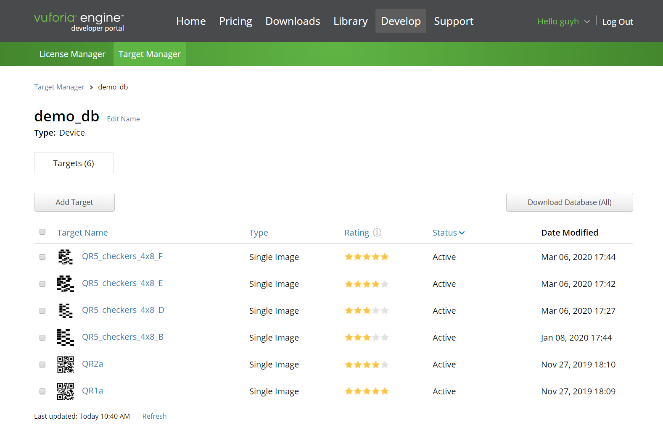
Results - Vuforia targets
https://developer.vuforia.com/target-manager
Notes:
Detection time – Immediate – 5 star. No detection – 0 star
Tracking distance – min 22-40cm, max 5m (depending on QR resolution not)
* All 5 star QRs behaved the same
Number of feature points correlates with star rating
No feature detection close to boundary

Slide 25
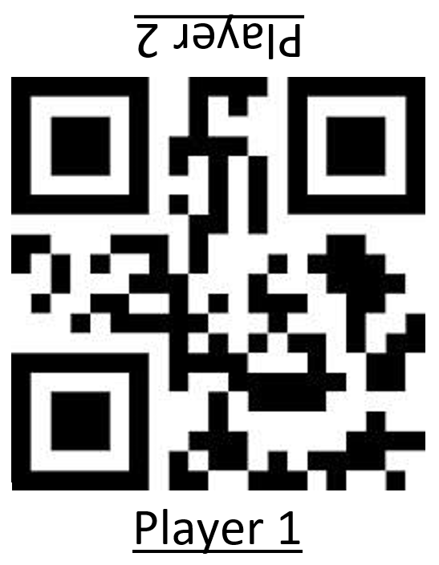
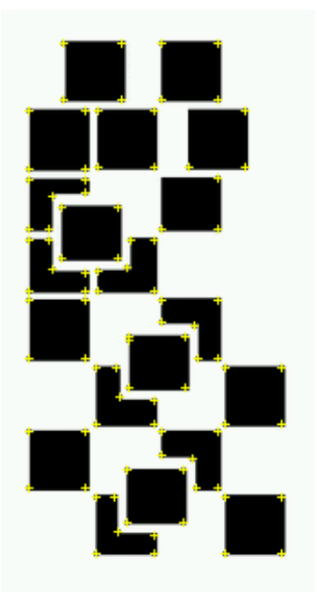
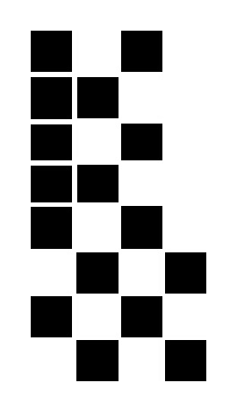
Results - Vuforia targets
Detection time
Tracking distance
#features ←→ rating
Feature boundary issue
Board target (5 stars)
QR5_4x8_F (5 stars)
QR5_4x8_B (3 stars)
https://developer.vuforia.com/target-manager
Notes:
Detection time – Immediate – 5 star. No detection – 0 star
Tracking distance – min 22-40cm, max 5m (depending on QR resolution not)
* All 5 star QRs behaved the same
Number of feature points correlates with star rating
No feature detection close to boundary

Slide 26
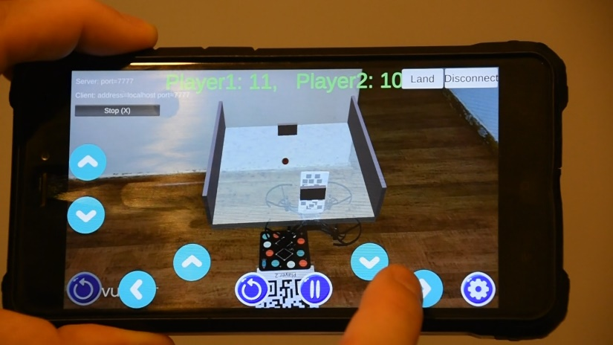
Results
Videos
Game Of Drones android app

Slide 27
Discussion & Conclusions

Slide 28
Discussion & Conclusions
Unity - hard to install (JDK, NDK), easy to program
Development (on PC) - easy debug, cross-platform = easy migration
Game experience (sound, drone control, drift, UI)
Network connection (wi-fi vs Internet, free-tau firewall)
Android device - Xiaomi Redmi 4 (low end device), image jitter
Notes:
Unity: very good for game development (complex installation due to external parts JDK, NDK) Development: debug in PC mode is fast and easy (using Log)
Game experience: enjoyable, even more with sound. Buttons (Pause, Resume, Restart) Network connection: both wi-fi & internet worked well (issue with free-tau firewall)
Android device: app is suitable for full range of devices. consider image stabilizer (HW or SW)

Slide 29
Discussion & Conclusions
Vuforia - easier to install than Unity, very good choice
Vuforia detection & tracking: - lighting (low, flickering - anti-banding) - target star rating - detection speed & distance - no features close to boundary - board target - limiting
Notes:
Vuforia: lots of moving parts, but works well (Target manager, Vuforia license, AR camera) Vuforia detection & tracking: - doesn’t work well in low lighting or flickering light (Neon)
- 0-star doesn’t detect, 3-star sometime need more time, 5-star immediate detection * all 5-star targets had similar performance (min: 25cm, max: 5m) – depending on resolution
- No features are detected close to target boundary (probably due to feature extraction algorithm – edge detection) - board target must always be in the frame

Slide 30
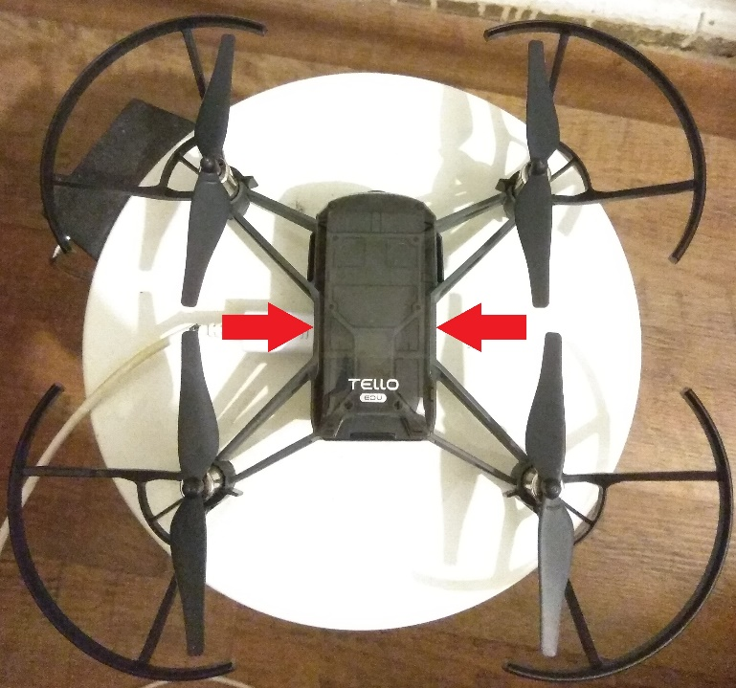
Discussion & Conclusions
Drone:
Drift (QR must be perfectly positioned)
Small perturbations (jitter)
Only indoor (weak wind causes a drift)
Drone position - hard to play w/o a marker
Air time (3-5 minutes is not enough)
Drone turning was not used
Notes:
- drift (QR position) - small position perturbation (hard to play with small wall) - indoor use only (due to winds)
- short air-time 3-5min (consider another drone)
- drone positioning – marker made it easier (and so, more fun)
- drone turning can be used in a different game

Slide 31
Discussion & Conclusions
Extras:
Anti-banding (None, 50Hz, 60Hz)
Focus Mode (ContAuto, Infinity, Macro, Normal, TrigAuto)
Video Mode (Default, Speed, Quality)
Flash light - negligible effect
Sound F/X - more fun (Sound On/Off)
Notes:
Anti-Banding: 50Hz - small effect
Focus Mode: “ContAuto” gave the best results
VideoMode: only “Default” worked (might require better cell device) Flash light: negligible effect
Sound F/X: more fun, but require Sound On/Off button!!!

Slide 32
Future Work
Drift cancelation - very important
3D model target
Collision avoidance
SLAM
Other game types - use drone turning
Use other pad functionality

Slide 33
Thank you for listening
Questions?

